Slide 1

LIBRARY MANAGEMENT SYSTEM
A course project presentation
on
By
P. KEERTHI PRIYA 2205A41L13
B. SRAVANTHI 2205A41L28
P. AKSHAYA 2205A41L22
Object oriented programming language using java

Slide 2
CONTENTS
1.Introduction
2.Objective
3.Key features of library management
4.Design
5.Functions of the systems
6.Conclusion

Slide 3
INTRODUCTION
A Library Management System (LMS) is a software application or a set of interconnected applications designed to facilitate the efficient management and operation of a library.
It serves as a comprehensive solution for organizing, cataloging.
Managing library resources, as well as automating various library processes.
The primary goal of a Library Management System is to streamline and enhance the overall functioning of a library.
Making it easier for librarians and library users to access, manage, and retrieve information.

Slide 4
OBJECTIVES:
The objectives of a Library Management System (LMS) are multifaceted, encompassing various aspects of library operations and services. The primary goals include improving efficiency, enhancing user services, and ensuring effective management of library resources. Here are some key objectives of a Library Management System:
Efficient Resource Management
User-Friendly Access
Membership and User Management
Circulation Control
Security and Access Control
User Education and Engagement

Slide 5
KEY FEATURES OF LMS:
Cataloging and Classification:
Efficient cataloging and classification of books, journals, multimedia, and other library materials.
Automated indexing and keyword-based search functionality for quick and easy retrieval of information.
Membership Management:
User registration and membership management, including issuing library cards.
Tracking borrower information, loan history, and managing user accounts.
Circulation Management:
Automation of the borrowing and returning process.
Overdue reminders and fines management.
Reservation and renewal of library materials.
Inventory Management:
Tracking and managing the library's inventory of books, periodicals, multimedia, and other resources.
Automated updates for additions, removals, and inventory status.

Slide 6
5.Reports and Analytics:
Generation of various reports, such as circulation statistics, overdue items, and inventory reports.
Data analytics to understand user behavior, popular items, and other insights for better decision-making.
6.Security and Access Control:
Ensuring data security and privacy of library users.
Access controls to restrict unauthorized access to sensitive information.
7.Interlibrary Loan Management:
Facilitating the borrowing and lending of materials between different libraries.
8.Integration with RFID and Barcoding:
Utilizing technology such as RFID tags and barcodes for efficient tracking of library items.0
9.Multi-Branch Support:
Support for libraries with multiple branches, enabling centralized management and coordination.

Slide 7
ELEMENTS USED IN PROJECT:
User roles
Courses
Communication
User management
User interface(UI)
Simple interface

Slide 8
DESIGN:
In the context of a Library Management System (LMS) implemented using Java, the design section refers to the architectural and structural aspects of the software. This includes how different components, modules, and classes are organized to achieve the functionality required by the system. Here are some key considerations for designing the system:
Class design
User Interface design
System architecture
Exception Handling
Security design

Slide 9
IMPLEMENTATION:
Certainly! Implementing a Library Management System (LMS) in Java involves writing code for various functionalities such as cataloging books, managing users, handling transactions, and more. Below is a simplified example of Java code for a basic library management system. This example focuses on key components, and you may need to expand and refine it based on your specific requirements.

Slide 10
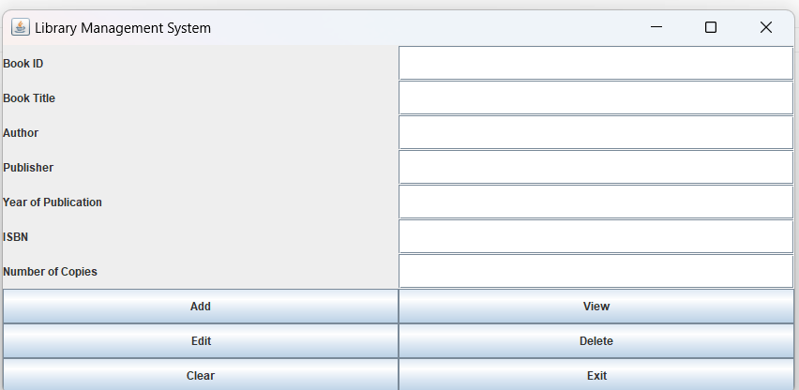
SCREENS
Home Page:

Slide 11
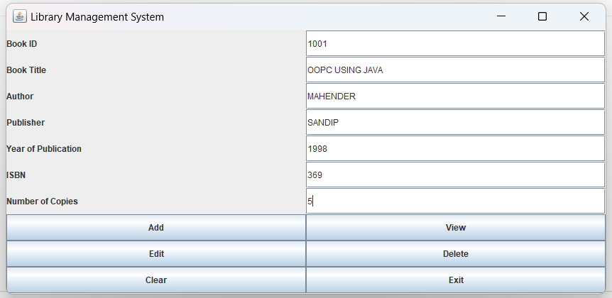
Adding the details:

Slide 12
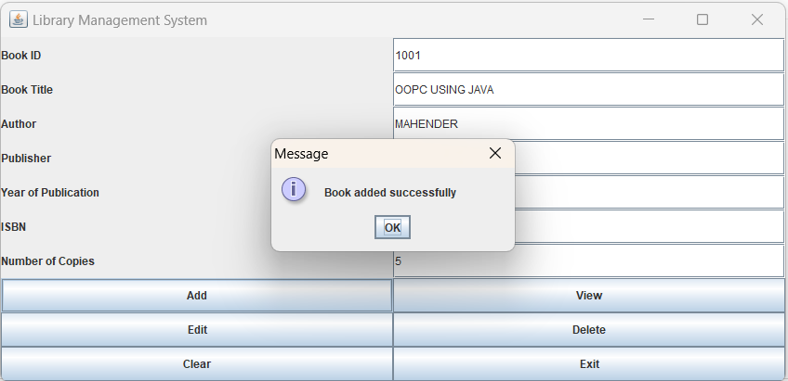
Book added:

Slide 13
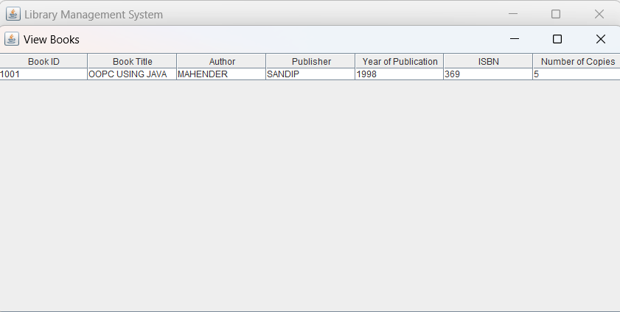
Viewing the Books:

Slide 14
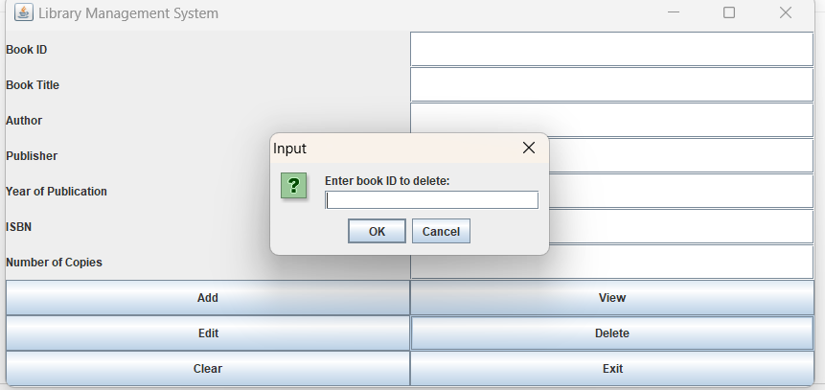
Deleting the books:

Slide 15
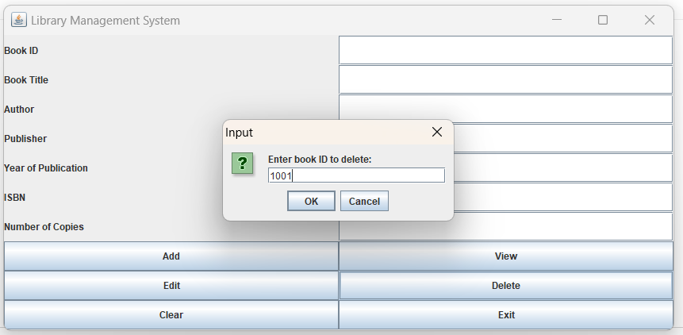

Slide 16
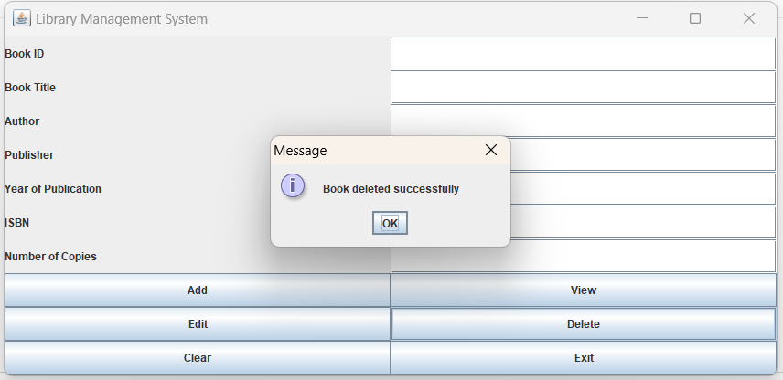

Slide 17
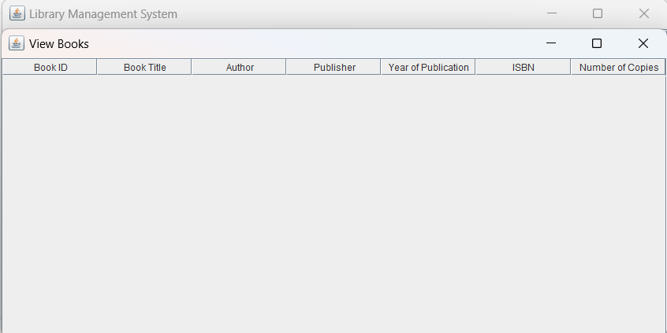

Slide 18
CONCLUSION
In conclusion, a Library Management System (LMS) developed using Java presents a comprehensive and efficient solution for automating and optimizing the various processes involved in managing a library. The combination of Java's platform independence, robust features, and the flexibility of the Swing framework for creating graphical user interfaces results in a system that is not only functional but also user-friendly. The key features integrated into the system contribute to the seamless organization of library resources and enhance the overall experience for both library staff and patrons.
The user authentication and authorization mechanisms ensure secure access control, while the catalog management system provides a structured approach to organizing and retrieving information about library materials. The check-in/check-out automation simplifies the circulation of items, and the reservation and renewal features offer flexibility to library users.

